Slide 1
IPL DATA
Vijay Shankar

Slide 2
INDEX
Slides 3 & 4 → CREATE TABLE QUERIES
Slides 5 & 6 → BATSMAN STRIKE RATE
Slides 7 to 9 → AVERAGE SCORE OF BATSMAN
Slides 10 & 11 → BOUNDARY PERCENTAGE OF BATSMAN
Slides 12 & 13 → BOWLER ECONOMY RATE
Slides 14 to 16 → BOWLER STRIKE RATE
Slides 17 & 18 → ALL ROUNDER
Slides 19 & 20 → CRITERIA FOR WICKET KEEPER
Slides 21 to 29 → FINAL ASSESSMENT QUESTIONS

Slide 3
CREATE TABLE QUERY FOR MATCHES TABLE
CREATE TABLE Matches
(id INT NOT NULL PRIMARY KEY, city VARCHAR(50) NOT NULL,
date DATE NOT NULL, player_of_match VARCHAR(50),
venue VARCHAR, neutral_venue BIT,
team1 VARCHAR(50), team2 VARCHAR(50),
toss_winner VARCHAR(50), toss_decision VARCHAR(10),
winner VARCHAR(50), result VARCHAR(15),
result_margin INT, eliminator VARCHAR(10),
method VARCHAR(10), umpire1 VARCHAR(50),
umpire2 VARCHAR(50));
COPY Matches FROM 'C:\Program Files\PostgreSQL\IPL Dataset\IPL Dataset\IPL_matches.csv'
DELIMITER ',' CSV HEADER;

Slide 4
CREATE TABLE QUERY FOR DELIVERIES TABLE
CREATE TABLE Deliveries
( id INT NOT NULL, CONSTRAINT FKEY_ID FOREIGN KEY (id) REFERENCES Matches(id),
inning INT, over INT,
ball INT, batsman VARCHAR(50),
non_striker VARCHAR(50), bowler VARCHAR(50),
batsman_runs INT, extra_runs INT,
total_runs INT, is_wicket INT,
dismissal_kind VARCHAR(50), player_dismissed VARCHAR(50),
fielder VARCHAR(50), extras_type VARCHAR(20),
batting_team VARCHAR(100), bowling_team VARCHAR(50));
COPY Deliveries FROM 'C:\Program Files\PostgreSQL\IPL Dataset\IPL Dataset\IPL_Ball.csv'
DELIMITER ',' CSV HEADER;

Slide 5
Q1 - Your first priority is to get 2-3 players with high S.R who have faced at least 500 balls. And
to do that you have to make a list of 10 players you want to bid in the auction so that
when you try to grab them in auction you should not pay the amount greater than you
have in the purse for a particular player.
(strike rate is total runs scored by batsman divided by number of balls faced but remember
when extras_type is 'wides’ it is not counted as a ball faced neither counted as batsmen runs)
QUERY
SELECT batsman, ROUND(SUM(batsman_runs)/CAST(COUNT(ball) as DECIMAL)*100,3) AS Strike_Rate,
SUM(batsman_runs) AS sum_of_runs, COUNT(ball) AS balls_faced
FROM deliveries
WHERE extras_type NOT IN ('wides')
GROUP BY batsman
HAVING COUNT(ball) >= 500
ORDER BY Strike_Rate DESC
LIMIT 10;

Slide 6
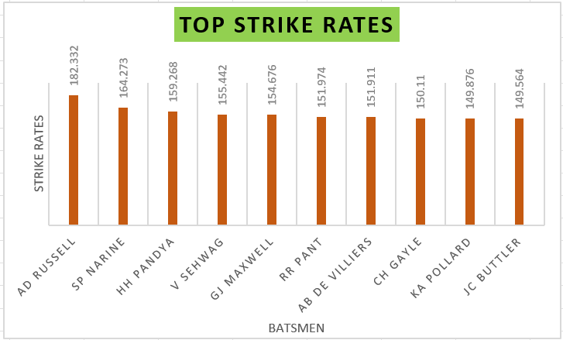
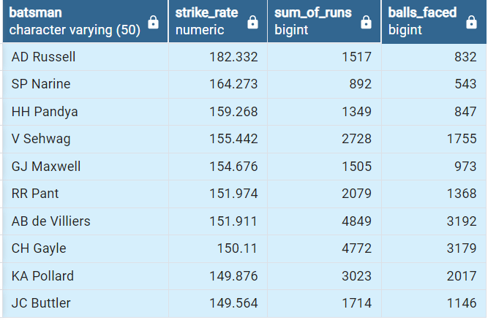

Slide 7
Q2 - Now you need to get 2-3 players with good Average who have played more than 2 ipl
seasons. And to do that you have to make a list of 10 players you want to bid in the
auction so that when you try to grab them in auction you should not pay the amount
greater than you have in the purse for a particular player.
(Average is calculated as total runs scored divided by number of times batsman has been
dismissed which can be calculated using wicket_ball field as 1 indicates out and 0 indicates not
out, a batsman should’ve been dismissed at least once to calculate the sr i.e., you can exclude
those players who have not been dismissed once )
QUERY
SELECT batsman, ROUND(CAST(SUM(d.batsman_runs) AS DECIMAL)/SUM(d.is_wicket),2) AS avg_score,
SUM(d.batsman_runs) AS total_runs_scored, SUM(is_wicket) AS times_dismissed,
COUNT(DISTINCT(EXTRACT(YEAR FROM m.date))) AS no_seasons_played
FROM deliveries AS d INNER JOIN matches AS m
ON d.id = m.id
GROUP BY d.batsman
HAVING SUM(is_wicket)>=1 AND COUNT(DISTINCT(EXTRACT(YEAR FROM m.date))) > 2
ORDER BY avg_score DESC
LIMIT 11;

Slide 8
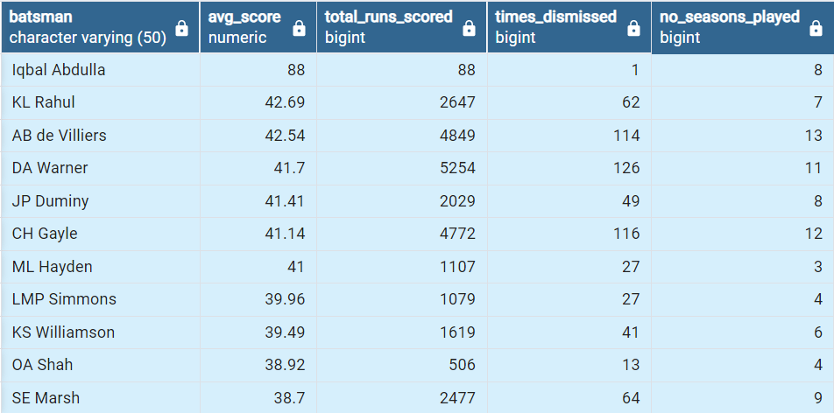
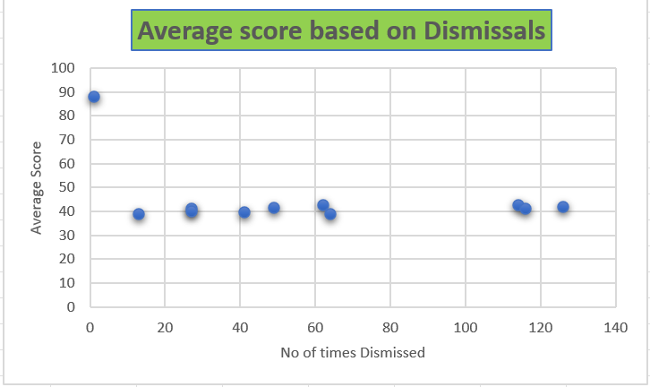

Slide 9
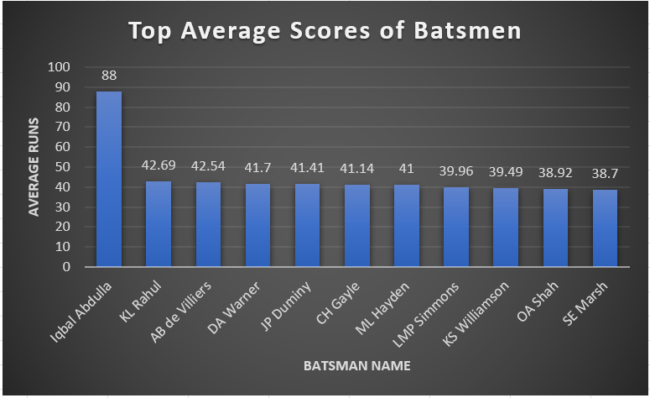
NOTE: In the query for Average score, 11 batsmen have been included because the batsman
with the top average (88) has been dismissed only once and may be considered as exception.

Slide 10
Q3 - Now you need to get 2-3 Hard-hitting players who have scored most runs in boundaries
and have played more the 2 ipl season. To do that you have to make a list of 10 players
you want to bid in the auction so that when you try to grab them in auction you should
not pay the amount greater than you have in the purse for a particular player.
(only 4 and 6 will be counted as boundaries so calculate how many 4 and 6 has been hit by
each batsman and also calculate total runs scored to get the output as boundary percentage
which will be runs in boundary divided by total runs scored)
QUERY
SELECT d.batsman,
ROUND(SUM(CASE WHEN batsman_runs IN (4,6) THEN batsman_runs ELSE 0 END)/CAST(SUM(batsman_runs) AS DECIMAL) * 100,3)
AS boundary_percentage,
SUM(CASE WHEN batsman_runs IN (4,6) THEN batsman_runs ELSE 0 END) AS runs_from_boundaries,
SUM(batsman_runs) AS total_score,
SUM(CASE WHEN batsman_runs IN (4,6) THEN 1 ELSE 0 END) AS no_of_boundaries,
COUNT(DISTINCT EXTRACT(YEAR FROM m.date)) AS no_seasons_played
FROM Deliveries AS d INNER JOIN Matches AS m
ON d.id = m.id
WHERE batsman_runs > 0
GROUP BY d.batsman
HAVING COUNT(DISTINCT(EXTRACT(YEAR FROM m.date))) > 2
ORDER BY boundary_percentage DESC
LIMIT 10;

Slide 11
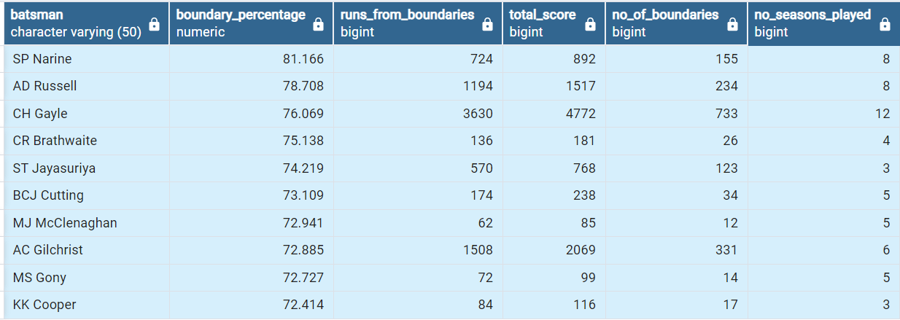
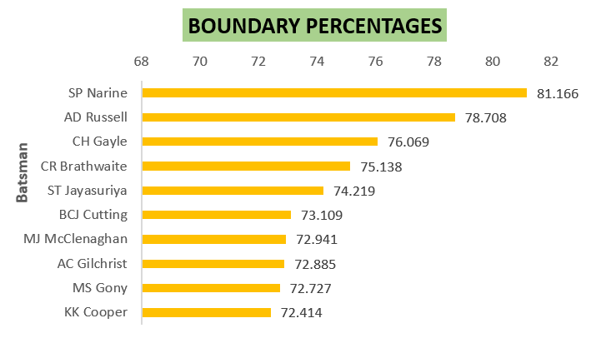

Slide 12
Q4 - Your first priority is to get 2-3 bowlers with good economy who have bowled at least 500
balls in IPL so far. To do that you have to make a list of 10 players you want to bid in the
auction so that when you try to grab them in auction you should not pay the amount
greater than you have in the purse for a particular player.(economy can be calculated by
dividing total runs conceded with total overs bowled)
QUERY
SELECT bowler,
ROUND(CAST(SUM(total_runs) AS decimal)/(COUNT(ball)/6),2) AS economy,
COUNT(ball) AS balls_bowled,
CAST(COUNT(ball)/6 AS DECIMAL) AS overs_bowled,
SUM(total_runs) AS runs_conceded
FROM deliveries
GROUP BY bowler
HAVING COUNT(ball) >= 500
ORDER BY economy
LIMIT 10;

Slide 13
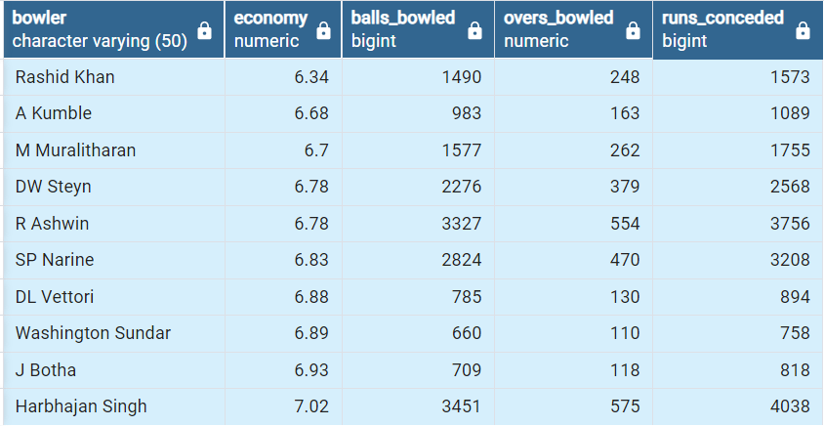
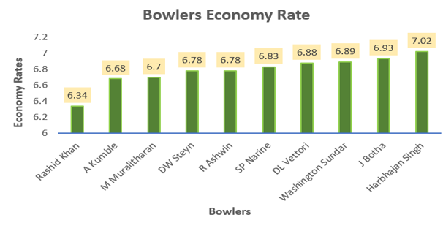

Slide 14
Q5- Now you need to get 2-3 bowlers with the best strike rate and who have bowled at least
500 balls in IPL so far. To do that you have to make a list of 10 players you want to bid in
the auction so that when you try to grab them in auction you should not pay the amount
greater than you have in the purse for a particular player.
(strike rate of a bowler can be calculated by number of balls bowled divided by total wickets
taken)
QUERY
SELECT bowler,
ROUND(CAST(COUNT(ball) AS DECIMAL)/SUM(is_wicket),3) AS bowler_strike_rate,
COUNT(ball) AS balls_bowled,
SUM(is_wicket) AS wickets_taken
FROM deliveries
GROUP BY bowler
HAVING COUNT(ball) >= 500 AND SUM(is_wicket) != 0
ORDER BY bowler_strike_rate
LIMIT 10;

Slide 15
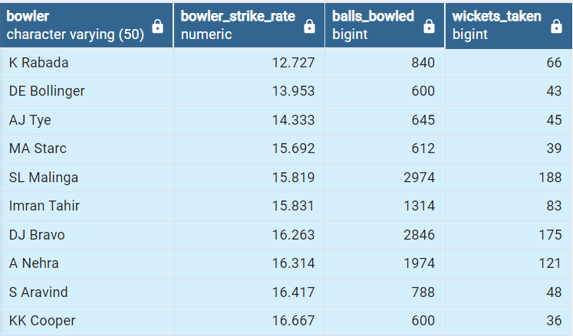
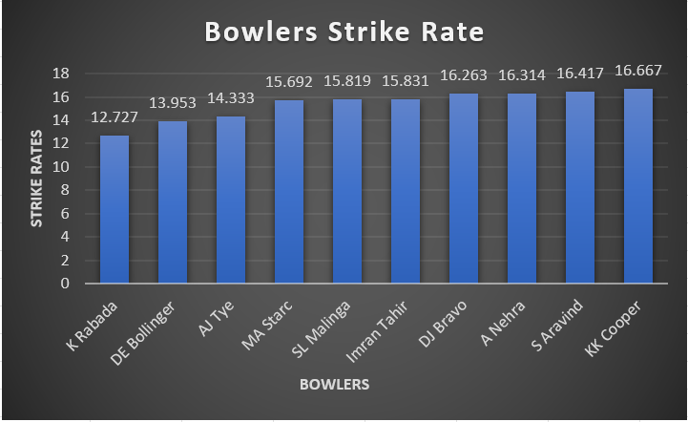

Slide 16
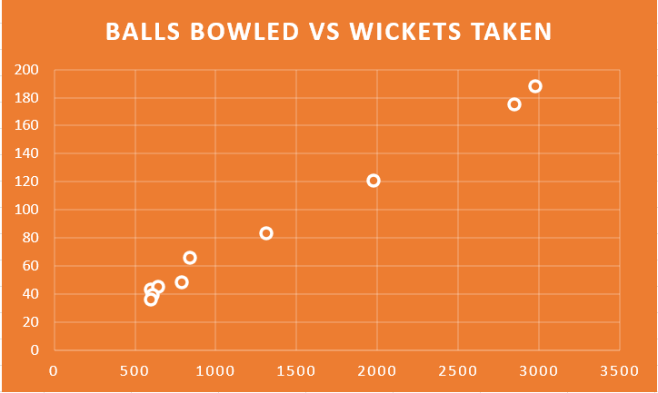

Slide 17
Q6 - Now you need to get 2-3 All_rounders with the best batting as well as bowling strike rate
and who have faced at least 500 balls in IPL so far and have bowled minimum 300
balls.To do that you have to make a list of 10 players you want to bid in the auction so
that when you try to grab them in auction you should not pay the amount greater than
you have in the purse for a particular player.
( strike rate of an all rounder can be calculated using the same criteria of batsman similarly the
bowling strike rate can be calculated using the criteria of a bowler)
QUERY
SELECT a.batsman AS all_rounder,
ROUND(SUM(a.batsman_runs)/CAST(COUNT(a.ball) AS DECIMAL)*100,3) AS batting_strike_Rate,
bowling_strike_rate
FROM deliveries AS a
INNER JOIN
(SELECT bowler, COUNT(ball) AS balls_bowled,
ROUND(CAST(COUNT(ball) AS DECIMAL)/SUM(is_wicket),3) AS bowling_strike_rate FROM deliveries
GROUP BY bowler
HAVING COUNT(ball) >= 300 AND SUM(is_wicket) != 0
ORDER BY bowling_strike_rate) AS b
ON a.batsman = b.bowler
WHERE extras_type NOT IN ('wides')
GROUP BY batsman, bowling_strike_rate
HAVING COUNT(ball) >= 500
ORDER BY batting_strike_rate DESC
LIMIT 10;

Slide 18
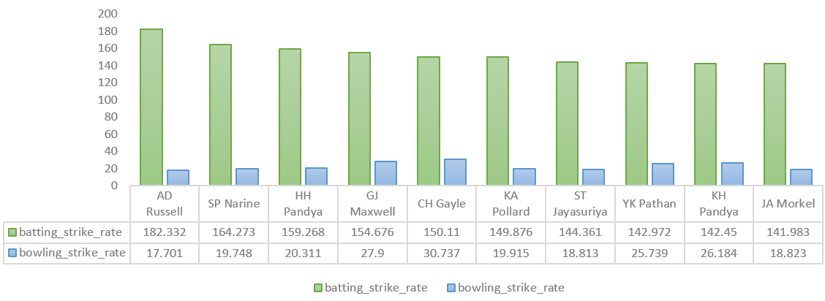

Slide 19
CRITERIA FOR WICKET KEEPER
A wicket keeper has to be agile and must have taken many wickets by stumping. In addition to this, he must be a hard hitter meaning that he should have hit lot of boundaries.
Such a person could be a middle order batsman who can add runs to the score-card swiftly with boundaries.
Thus to select wicket keepers, the number of stumpings done by player and his boundary percentage could be taken into account.
The Wicket keeper can be identified from the given data by filtering the data with respect to the dismissal_kind as stumped.
The stumping count could be grouped based on the wicket_keeper and sorted in descending order.
In addition to this, the boundary percentage which is the proportion of runs which came from boundaries can be also included to get a better picture of their hitting abilities.

Slide 20
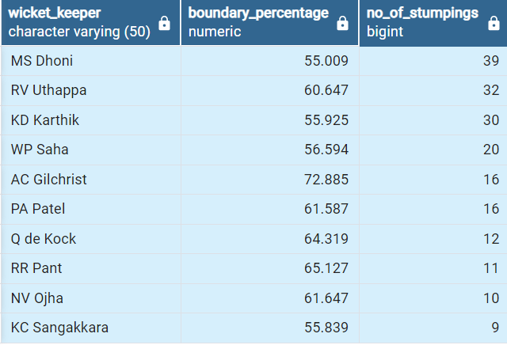
SAMPLE QUERY
SAMPLE OUTPUT TABLE
SELECT a.batsman AS wicket_keeper,
ROUND(SUM(CASE WHEN batsman_runs IN (4,6) THEN batsman_runs ELSE 0 END)/CAST(SUM(batsman_runs) AS DECIMAL) * 100,3)
AS boundary_percentage, no_of_stumpings
FROM deliveries AS a
INNER JOIN
(SELECT fielder, COUNT(dismissal_kind) AS no_of_stumpings FROM deliveries
WHERE dismissal_kind = 'stumped'
GROUP BY fielder
ORDER BY no_of_stumpings DESC) AS b
ON a.batsman = b.fielder
GROUP BY batsman, no_of_stumpings
HAVING SUM(batsman_runs) > 0
ORDER BY no_of_stumpings DESC;

Slide 21
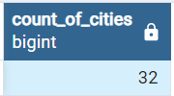
ADDITIONAL QUESTIONS FOR FINAL ASSESSMENT
1. Get the count of cities that have hosted an IPL match
SELECT COUNT(DISTINCT(city)) AS count_of_cities
FROM matches
WHERE city != 'NA';
2. Create table deliveries_v02 with all the columns of the table ‘deliveries’ and an additional
column ball_result containing values boundary, dot or other depending on the total_run
(boundary for >= 4, dot for 0 and other for any other number)
(Hint 1 : CASE WHEN statement is used to get condition based results)
(Hint 2: To convert the output data of the select statement into a table, you can use a
subquery. Create table table_name as [entire select statement].
CREATE TABLE deliveries_v02 AS
SELECT *, CASE WHEN total_runs >=4 THEN 'boundary'
WHEN total_runs = 0 THEN 'dot'
ELSE 'other'
END AS ball_result
FROM deliveries;
SELECT * FROM deliveries_v02;

Slide 22
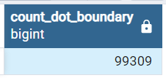
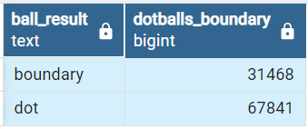
3. Write a query to fetch the total number of boundaries and dot balls from the
deliveries_v02 table.
SELECT COUNT(ball_result) AS count_dot_boundary
FROM deliveries_v02
WHERE ball_result IN ('dot', 'boundary');
SELECT ball_result, COUNT(ball_result) as dotballs_boundary
FROM deliveries_v02
WHERE ball_result IN ('boundary', 'dot')
GROUP BY ball_result;
4.Write a query to fetch the total number of boundaries scored by each team from the
deliveries_v02 table and order it in descending order of the number of boundaries
scored.
SELECT batting_team, COUNT(ball_result) AS tot_boundaries
FROM deliveries_v02
WHERE ball_result = 'boundary'
GROUP BY batting_team
ORDER BY tot_boundaries DESC;

Slide 23
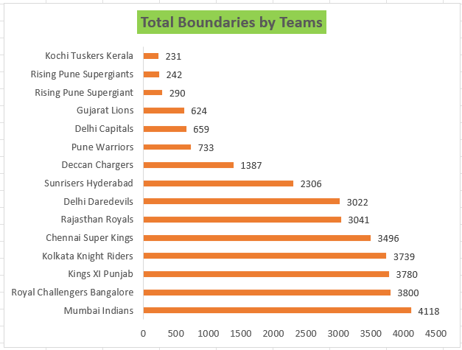
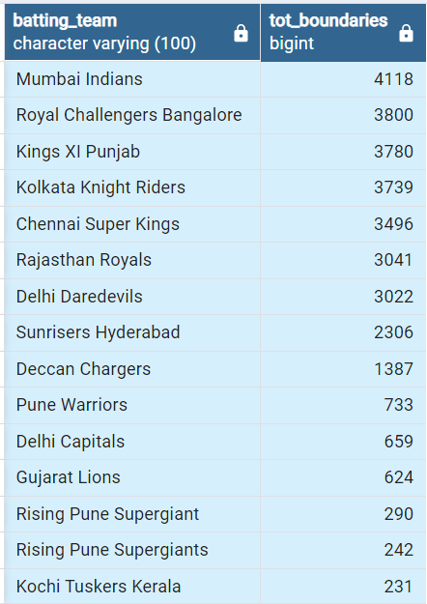

Slide 24
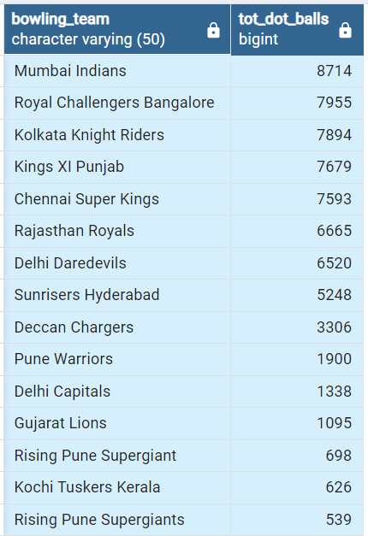
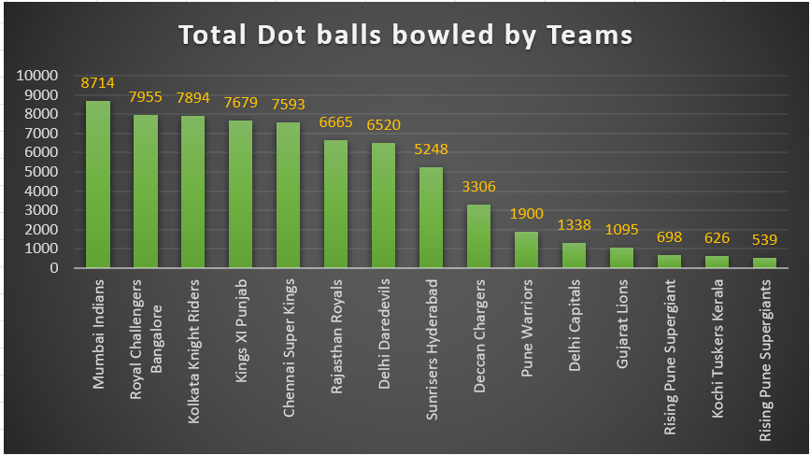
5. Write a query to fetch the total number of dot balls bowled by each team and order it in
descending order of the total number of dot balls bowled.
SELECT bowling_team, COUNT(ball_result) AS tot_dot_balls
FROM deliveries_v02
WHERE ball_result = 'dot' AND bowling_team != 'NA'
GROUP BY bowling_team
ORDER BY tot_dot_balls DESC;

Slide 25
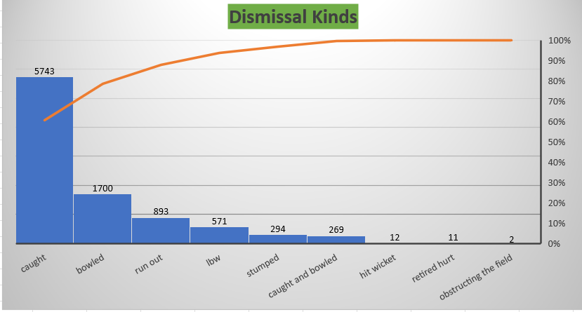
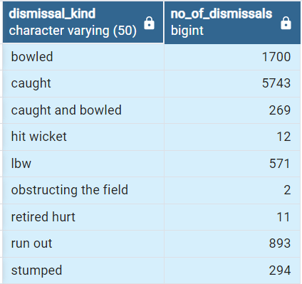
6. Write a query to fetch the total number of dismissals by dismissal kinds where dismissal
kind is not NA.
SELECT dismissal_kind, COUNT(dismissal_kind) as no_of_dismissals
FROM deliveries_v02
WHERE dismissal_kind != 'NA'
GROUP BY dismissal_kind;

Slide 26
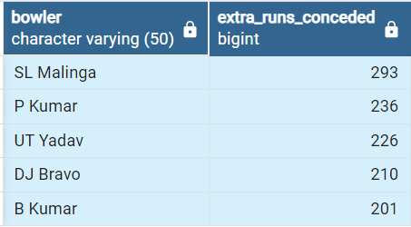
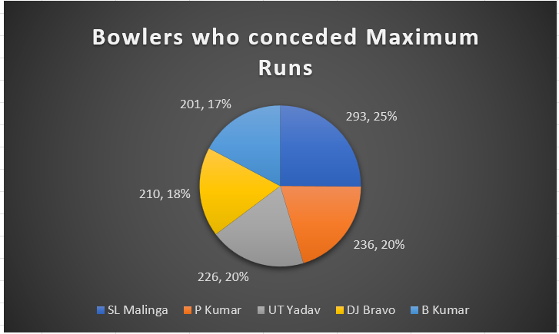
7. Write a query to get the top 5 bowlers who conceded maximum extra runs from the deliveries table
SELECT bowler, SUM(extra_runs) AS extra_runs_conceded
FROM deliveries
GROUP BY bowler
ORDER BY extra_runs_conceded DESC
LIMIT 5;

Slide 27
8. Write a query to create a table named deliveries_v03 with all the columns of
deliveries_v02 table and two additional column (named venue and match_date) of venue
and date from table matches
CREATE TABLE deliveries_v03 AS
SELECT a.*, b.venue, b.date AS match_date FROM deliveries_v02 AS a
LEFT JOIN matches as b
ON a.id = b.id;
SELECT * FROM deliveries_v03;
9. Write a query to fetch the total runs scored for each venue and order it in the descending
order of total runs scored.
SELECT venue, SUM(total_runs) AS total_in_venue
FROM deliveries_v03
GROUP BY venue
ORDER BY total_in_venue DESC;

Slide 28
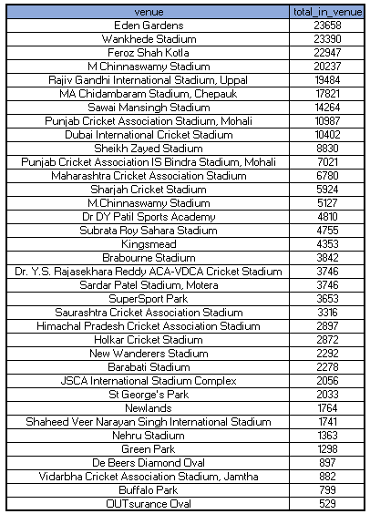
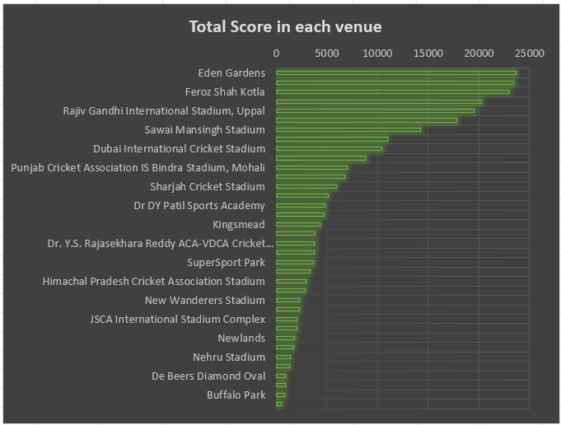

Slide 29
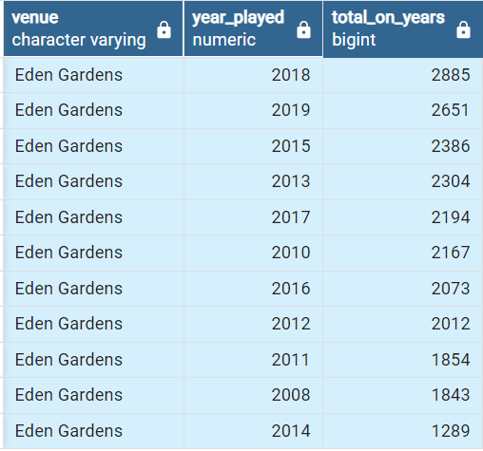
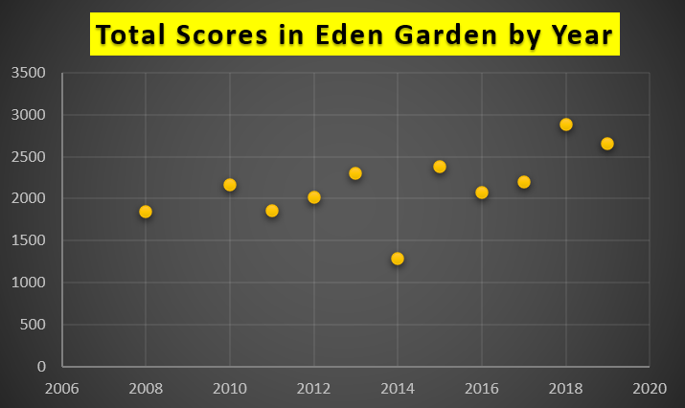
10. Write a query to fetch the year-wise total runs scored at Eden Gardens and order it in the
descending order of total runs scored.
SELECT venue, EXTRACT(YEAR FROM match_date) AS year_played, SUM(total_runs) AS total_on_years
FROM deliveries_v03
WHERE venue = 'Eden Gardens'
GROUP BY venue, year_played
ORDER BY total_on_years DESC;

